Slide 1
DATABASE DESIGN THEORY AND NORMALIZATION
Chapter - 6

Slide 2
Outline
Informal Design Guidelines for Relational Databases
  Semantics of the Relation Attributes
  Redundant Information in Tuples and Update Anomalies
  Null Values in Tuples
  Spurious Tuples
Functional Dependencies (FDs)
  Definition of FD
  Inference Rules for FDs
  Equivalence of Sets of FDs
  Minimal Sets of FDs

Slide 3
Outline
Normal Forms Based on Primary Keys
  Normalization of Relations
  Practical Use of Normal Forms
  Definitions of Keys and Attributes Participating in Keys
  First Normal Form
  Second Normal Form
  Third Normal Form
General Normal Form Definitions (For Multiple Keys)
BCNF (Boyce-Codd Normal Form)
Multivalued Dependency and Fourth Normal Form
Join Dependencies and Fifth Normal Form

Slide 4
Review : Database Design
Requirements Analysis
  user needs; what must database do?
Conceptual Design
  high level description (often done w/ER model)
Logical Design
  translate ER into DBMS data model
Schema Refinement
  consistency, normalization
Physical Design - indexes, disk layout
Security Design - who accesses what

Slide 5
Design Steps
Step (3) to step (4) is based on a “design theory” for relations and is called “normalization”
It is important for two reasons
  Automatic mappings from ER to relations may not produce the best relational design possible
  Database designers may go directly from (1) to (3), in which case, the relational design can be really bad

Slide 6
Relational Database Design
Relational database design ultimately produces a set of relations
The implicit goals of the design activity are
  Information preservation
    Maintaining all concepts, including attribute types, entity types, and relationship types as well as generalization/specialization relationships, which are described using a model such as the EER model
  Minimum redundancy
    Minimizing redundant storage of the same information and reducing the need for multiple updates to maintain consistency across multiple copies of the same information in response to real-world events that require making an update

Slide 7
Informal Design Guidelines for Relational Databases
Four informal guidelines that may be used as measures to determine the quality of relation schema design
  Making sure that the semantics of the attributes is clear in the schema
  Reducing the redundant information in tuples
  Reducing the NULL values in tuples
  Disallowing the possibility of generating spurious tuples

Slide 8
Semantics of the Relation Attributes
GUIDELINE 1 :
  Informally, each tuple in a relation should represent one entity or relationship instance (Applies to individual relations and their attributes)
  Attributes of different entities (EMPLOYEEs, DEPARTMENTs, PROJECTs) should not be mixed in the same relation
    If the relation corresponds to a mixture of multiple entities and relationships, semantic ambiguities will result and the relation cannot be easily explained
  Only foreign keys should be used to refer to other entities
  Entity and relationship attributes should be kept apart as much as possible
Bottom Line: Design a schema that can be explained easily relation by relation. The semantics of attributes should be easy to interpret

Slide 9
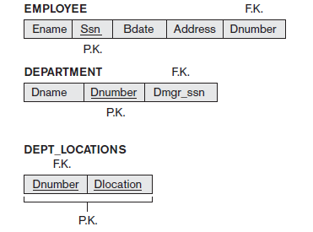
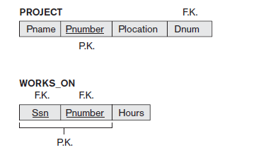
Informal Design Guidelines for Relational Databases
Figure : A simplified COMPANY relational database schema

Slide 10
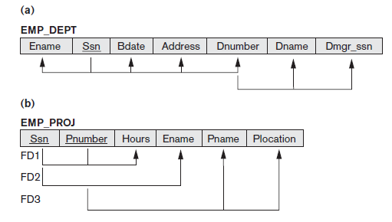
Examples of Violating Guideline 1
Violation of Guideline1 by mixing attributes from distinct real-world entities
EMP_DEPT mixes attributes of employees and departments, and EMP_PROJ mixes attributes of employees and projects and the WORKS_ON relationship
Hence, they are against
the above measure
of design quality

Slide 11
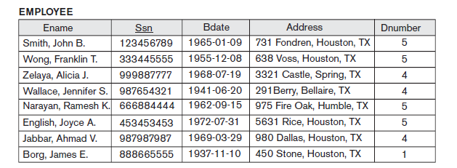
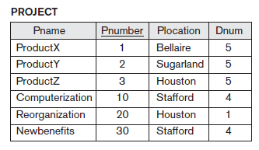
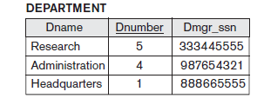
Sample Database State

Slide 12
Redundant Information in Tuples and Update Anomalies
One goal of schema design is to minimize the storage space used by the base relations
Grouping attributes into relation schemas has a significant effect on storage space
Storing natural joins of base relations leads to an additional problem referred to as update anomalies
Information is stored redundantly
  Wastes storage
  Causes problems with update anomalies
    Insertion anomalies
    Deletion anomalies
    Modification anomalies

Slide 13
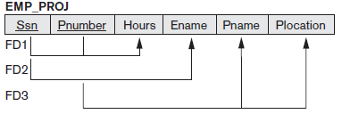
Example of an Modification Anomaly
Consider the relation
  EMP_PROJ(Emp#, Proj#, Ename, Pname, No_hours)
Update Anomaly
  Changing the name of project number P1 from “Billing” to “Customer-Accounting” may cause this update to be made for all 100 employees working on project P1

Slide 14
Example of an Insert Anomaly
Consider the relation
  EMP_PROJ(Emp#, Proj#, Ename, Pname, No_hours)
Insert Anomaly
  Cannot insert a project unless an employee is assigned to it
Conversely
  Cannot insert an employee unless an he/she is assigned to a project

Slide 15
Example of an Delete Anomaly
Consider the relation
  EMP_PROJ(Emp#, Proj#, Ename, Pname, No_hours)
Delete Anomaly
  When a project is deleted, it will result in deleting all the employees who work on that project
  Alternately, if an employee is the sole employee on a project, deleting that employee would result in deleting the corresponding project

Slide 16
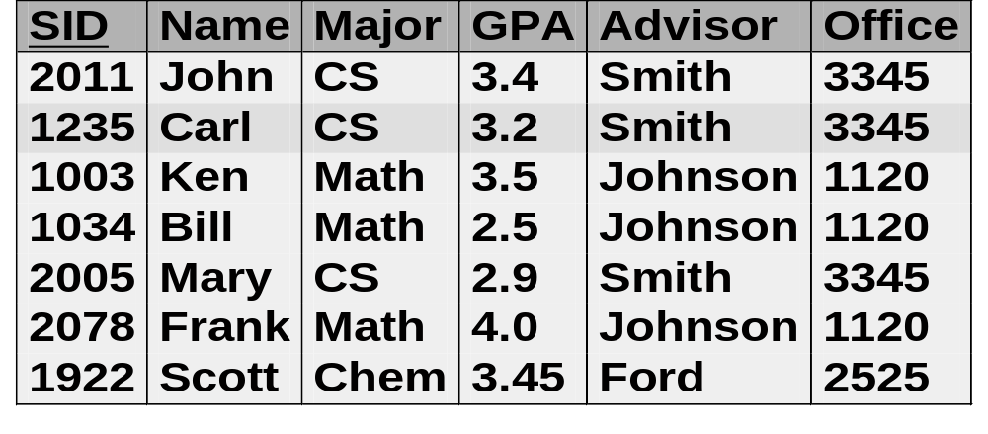
Update Anomalies
Example 2
Insertion anomaly: How to add a new major?
Modification anomaly: What would happen if we change office of Smith in the first tuple?
Deletion anomaly: What would happen if Scott is deleted?
Student_Advisor

Slide 17
Guideline to Redundant Information in Tuples and Update Anomalies
GUIDELINE 2
  Design a schema that does not suffer from the insertion, deletion and update anomalies
  If there are any anomalies present, then note them so that applications can be made to take them into account

Slide 18
Null Values in Tuples
Fat Relations: A relation in which too many attributes are grouped.
If many of the attributes do not apply to all tuples in the relation, we end up with many NULLs in those tuples
  This can waste space at the storage level and may also lead to problems with understanding the meaning of the attributes and with specifying JOIN operations at the logical level
Another problem with NULLs - How to account for them when aggregate operations such as COUNT or SUM are applied
Reasons for nulls
  Attribute not applicable or invalid
  Attribute value unknown (may exist)
  Value known to exist, but unavailable

Slide 19
Null Values in Tuples
GUIDELINE 3
  Relations should be designed such that their tuples will have as few NULL values as possible
  Attributes that are NULL frequently could be placed in separate relations (with the primary key)

Slide 20
Spurious Tuples
Bad designs for a relational database may result in erroneous results for certain join operations
Additional tuples that were not in the original relation are called spurious tuples because they represent spurious or wrong information that is not valid
spurious tuples created when two tables are joined on attributes that are neither primary keys nor foreign keys
GUIDELINE 4
  Design relation schemas so that they can be joined with equality conditions on attributes that are appropriately related (primary key, foreign key) pairs in a way that guarantees that no spurious tuples are generated
  Avoid relations that contain matching attributes that are not (foreign key, primary key) combinations because joining on such attributes may produce spurious tuples

Slide 21
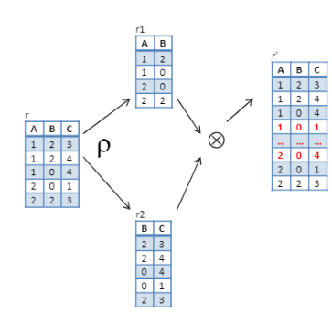
Spurious Tuples – Example 1

Slide 22
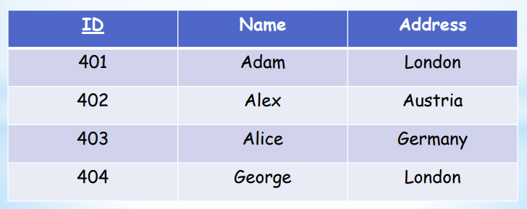
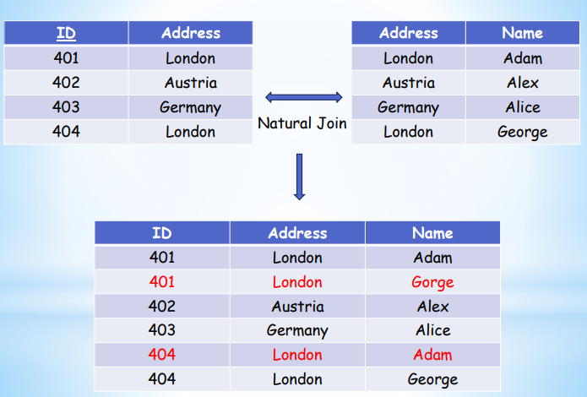
Spurious Tuples – Example 2

Slide 23
The Evils of Redundancy
Redundancy is at the root of several problems associated with relational schemas
  redundant storage, update anomalies
Integrity constraints, in particular functional dependencies, can be used to identify schemas with such problems and to suggest refinements
Main refinement technique: decomposition
Decomposition should be used judiciously:
  Is there a reason to decompose a relation?
  What problems does decomposition cause?

Slide 24
Functional Dependencies
A formal tool for analysis of relational schemas that enables us to detect and describe some of the above-mentioned problems in precise terms
Most important concept in relational schema design theory is that of a functional dependency
Functional dependencies (FDs) are used to specify formal measures of the "goodness" of relational designs
FDs and keys are used to define normal forms for relations
FDs are constraints that are derived from the meaning and interrelationships of the data attributes

Slide 25
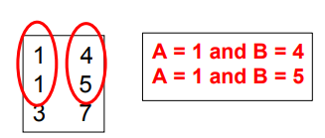
Functional Dependencies
Relational Schema R = {A1, A2, ... , An}
Definition
  A functional dependency(FD or f.d), denoted by X → Y, between two sets of attributes X and Y that are subsets of R specifies a constraint on the possible tuples that can form a relation state r of R
  The constraint is that, for any two tuples t1 and t2 in r that have t1[X] = t2[X], they must also have t1[Y] = t2[Y]
  X → Y in R specifies a constraint on all relation instances r(R)
Example : Consider r(A,B ) with the following instance of r
On this instance, A -> B does NOT hold, but B -> A does hold

Slide 26
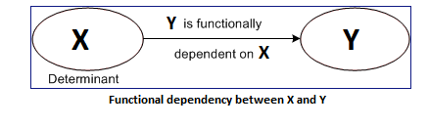
Functional Dependencies
FD means that the values of the Y component of a tuple in r depend on, or are determined by, the values of the X component
Alternatively, the values of the X component (left-hand side) of a tuple uniquely (or functionally) determine the values of the Y component (left-hand side)
We also say that there is a functional dependency from X to Y, or that Y is functionally dependent on X
In X->Y,
  X – Determinant Set
  Y – Dependent attribute
FDs are derived from the real-world constraints on the attributes

Slide 27
Functional Dependencies
For any relation R, attribute Y is functionally dependent on attribute X (usually the PK), if for every valid instance of X, that value of X uniquely determines the value of Y (X->Y)
Examples
  SSN -> ENAME
  PNUMBER -> {PNAME, PLOCATION}
  {SSN, PNUMBER} -> HOURS
The constraint must hold on every relation instance r(R)
If K is a key of R, then K functionally determines all attributes in R (since we never have two distinct tuples with t1[K]=t2[K])
If X→Y in R, this does not say whether or not Y→X in R

Slide 28
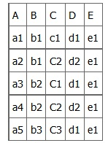
Functional Dependencies
Consider the following table of data r(R) of the relation schema R(A, B, C,D, E)
What kind of dependencies can we observe among the attributes in Table R?

Slide 29
Functional Dependencies
Since the values of A are unique (a1, a2, a3, etc.), it follows from the FD definition that: A → B, A → C, A → D, A → E
  It also follows that A →BC (or any other subset of ABCDE)
  This can be summarized as A →BCDE
  From our understanding of primary keys, A is a primary key
Since the values of E are always the same (all e1), it follows that:
A → E, B → E, C → E, D → E

Slide 30
Functional Dependencies
Other observations
  Combinations of BC are unique, therefore BC → ADE
  Combinations of BD are unique, therefore BD → ACE
  If C values match, so do D values.
    Therefore, C → D
    However, D values don’t determine C values
    So C does not determine D, and D does not determine C

Slide 31
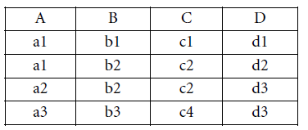
Functional Dependencies
Consider a relation R (A, B, C, D) with its extension
FDs of R
  B → C; C → B; {A, B} → C; {A, B} → D; and {C, D} → B
FDs do not hold
  A → B (tuples 1 and 2 violate this constraint)
  B → A (tuples 2 and 3 violate this constraint)
  D→C (tuples 3 and 4 violate it)

Slide 32
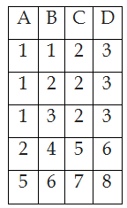
Functional Dependencies
Consider a relation R (A, B, C, D) with the following instance. Which of the following functional dependencies are satisfied by this relation?
  (a) A → B
  (b) A → CD
  (c) AB → CD
  (d) C → D
  (e) B → A
  (f) BD → AC
  (g) AD → BC
  (h) D → B
  (i) D → C
  (j) C → A
X->Y, X,Y ⊆ R
t1[X] =t2[X] => t1[Y] =t2[Y]

Slide 33
Functional Dependencies
Consider a relation R (A, B, C, D) with the following instance. Which of the following functional dependencies are satisfied by this relation?
  (a) A → B
  (b) A → CD
  (c) AB → CD
  (d) C → D
  (e) B → A
  (f) BD → AC
  (g) AD → BC
  (h) D → B
  (i) D → C
  (j) C → A

Slide 34
Inference Rules for FDs
Given a set of FDs F, we can infer additional FDs that hold whenever the FDs in F hold
Armstrong's inference rules
  Armstrong’s axioms are a set of inference rules used to infer all the functional dependencies on a relational database
  They were developed by William W. Armstrong
  IR1. (Reflexive) If X ⊇ Y, then X -> Y
  IR2. (Augmentation) If X -> Y, then XZ -> YZ
    (Notation: XZ stands for X U Z)
  IR3. (Transitive) If X -> Y and Y -> Z, then X -> Z
IR1, IR2, IR3 form a sound and complete set of inference rules
    These are rules hold and all other rules that hold can be deduced from these

Slide 35
Inference Rules for FDs
Sound
  Given a set of FDs specified on a relation schema R, any dependency that we can infer from F (set of functional dependencies that are specified on relation schema R) by using IR1 through IR3 holds in every relation state r of R that satisfies the dependencies in F
  ie., All dependencies generated by the Axioms are correct
Complete
  Using IR1 through IR3 repeatedly to infer dependencies until no more dependencies can be inferred results in the complete set of all possible dependencies that can be inferred from F
  ie., Repeatedly applying these rules can generate all correct dependency

Slide 36
Inference Rules for FDs
Some additional inference rules that are useful
  IR4. (Decomposition or Projective) If X -> YZ, then X -> Y and X -> Z
  IR5. (Union or additive) If X -> Y and X -> Z, then X -> YZ
  IR6. (Psuedotransitivity) If X -> Y and WY -> Z, then WX -> Z
Note: The last three inference rules (IR4, IR5, IR6) as well as any other inference rules, can be deduced from IR1, IR2, and IR3 (completeness property)

Slide 37
Inference Rules for FDs
  IR1. (Reflexive) If X ⊇ Y, then X -> Y
  If X is a set of attributes and Y is the subset of X, then X functionally determines Y
  The reflexive rule (IR1) states that a set of attributes always determines itself or any of its subsets, which is obvious. Because IR1 generates dependencies that are always true, such dependencies are called trivial
  Formally, a functional dependency X→Y is trivial if X ⊇ Y; otherwise, it is nontrivial
Note : The reflexive rule can also be stated as X → X; that is, any set of attributes functionally determines itself
Example
  Lastname ⊆ Firstname, Lastname then
  Firstname, Lastname → Lastname

Slide 38
Proof of IR1
  Reflexive : If X ⊇ Y, then X -> Y
Suppose that X ⊇ Y and that two tuples t1 and t2 exist in some relation instance r of R such that t1 [X] = t2 [X]
Then t1[Y] = t2[Y] because X ⊇ Y; hence, X→Y must hold in r
Example
  Lastname ⊆ Firstname, Lastname then
  Firstname, Lastname → Lastname

Slide 39
Inference Rules for FDs
  IR2. (Augmentation) If X -> Y, then XZ -> YZ
    If X determines Y and Z is any attribute set, then XZ determines YZ. It is also called as a partial dependency
  Adding the same set of attributes to both the left- and right-hand sides of a dependency results in another valid dependency
Example
  Regno → Firstname, Lastname, then
  Regno, address → Firstname, Lastname, address
Note
  The augmentation rule can also be stated as X → Y, then XZ → Y; that is, augmenting the left-hand side attributes of an FD produces another valid FD

Slide 40
Proof of IR2
Augmentation : If X -> Y, then XZ -> YZ
Assume that X → Y hold in a relation instance r of R but that XZ → YZ does not hold
Then there must be exist two tuples t1 and t2 in r such that
  (1) t1[X] = t2[X]
  (2) t1[Y] = t2[Y]
  (3) t1[XZ] = t2[XZ]
  (4) t1[YZ] ≠ t2[YZ]
This is not possible because
(5) t1[Z] = t2[Z] from (1) and (3),
(6) t1[YZ] = t2[YZ] from (2) and (5) contradicting (4)

Slide 41
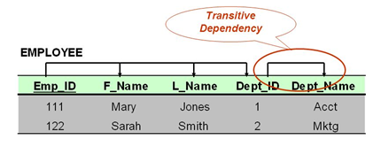
Inference Rules for FDs
  IR3. (Transitive) If X -> Y and Y -> Z, then X -> Z
  IR3 says functional dependencies are transitive
  if X determines Y and Y determines Z, then X also determines Z
  Example
  Emp_id→ Dept_id
  Dept_id →Dept_Name

Slide 42
Proof of IR3
  Transitive: If X -> Y and Y -> Z, then X -> Z
Assume that
(1) X → Y and
(2) Y → Z both hold in a relation r
Then for any two tuples t1 and t2 in r such that t1 [X] = t2 [X], we must have
(3) t1 [Y] = t2 [Y], from assumption (1);
Hence we must also have
(4) t1 [Z] = t2 [Z] from (3) and assumption (2)
Thus, X→Z must hold in r

Slide 43
Proof of IR4
  Decomposition or Projective : If X -> YZ, then X -> Y and X -> Z
1. X→YZ (given)
2. YZ→Y (using IR1 and knowing that YZ ⊇ Y)
3. X→Y (using IR3 on 1 and 2)
Example
Rollno → Firstname, Lastname then
Rollno → Firstname and Rollno → Lastname

Slide 44
Proof of IR5
  Union or additive : If X -> Y and X -> Z, then X -> YZ
1. X→Y (given)
2. X→Z (given)
3. X→XY (using IR2 on 1 by augmenting with X; notice that XX = X)
4. XY→YZ (using IR2 on 2 by augmenting with Y)
5. X→YZ (using IR3 on 3 and 4)
Example
Rollno → name and Rollno → address then
Rollno → name, address

Slide 45
Proof of IR6
  Psuedotransitivity : If X -> Y and WY -> Z, then WX -> Z
1. X→Y (given)
2. WY→Z (given)
3. WX→WY (using IR2 on 1 by augmenting with W)
4. WX→Z (using IR3 on 3 and 2)
Example
Rollno → name and name,marks →percentage, then
Rollno,marks → percentage

Slide 46
Functional Dependencies
Suppose we are given a relation scheme R = (A,B,C,G,H,I), and the set of functional dependencies, F provided below:
A → B
A → C
CG → H
CG → I
B → H
Is A → H logically implied by F? ==>Yes (by using IR3)
Is AG → I logically implied by F? ==> Yes (by using IR2 and IR3)

Slide 47
Closure
Closure of a set F of FDs is the set F⁺ of all FDs that can be inferred from F
Closure of a set of attributes X with respect to F is the set X⁺ of all attributes that are functionally determined by X
X⁺ can be calculated by repeatedly applying IR1, IR2, IR3 using the FDs in F
Definition
  For each such set of attributes X, we determine the set X⁺ of attributes that are functionally determined by X based on F; X⁺ is called the closure of X under F

Slide 48
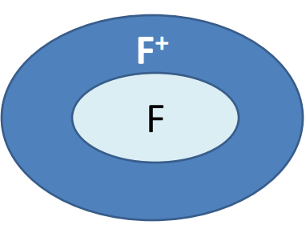
Closure of a set F of FDs (F⁺)
Assume that there are 4 attributes A, B, C, D in a relation R and that F = {A → B, B → C}
Then, F⁺ includes all the following FDs
A → A, A → B, A → C, B → B, B → C, C → C, D → D, AB → A, AB → B, AB → C, AC → A, AC → B, AC → C, AD → A, AD → B, AD → C, AD → D, BC → B, BC → C, BD → B, BD → C, BD → D, CD → C, CD → D, ABC → A, ABC → B, ABC → C, ABD → A, ABD → B, ABD → C, ABD → D, BCD → B, BCD → C, BCD → D, ABCD → A, ABCD → B, ABCD → C, ABCD → D
Note : Computing the closure of a set of FDs (F⁺) can be expensive. (Size of closure is exponential in # attributes!)

Slide 49
Closure of an Attribute X
Computing the closure of a set of FDs (F⁺) can be expensive
(Size of closure is exponential in # attributes!)
Typically, we just want to check if a given FD X ->Y is in the closure of a set of FDs F - An efficient check
  Compute attribute closure of X (denoted X⁺ ) wrt F:
    Set of all attributes A such that X ->A is in
    There is a linear time algorithm to compute this
    For each FD Y -> Z in F, if X⁺ is a superset of Y then add Y to X⁺

Slide 50
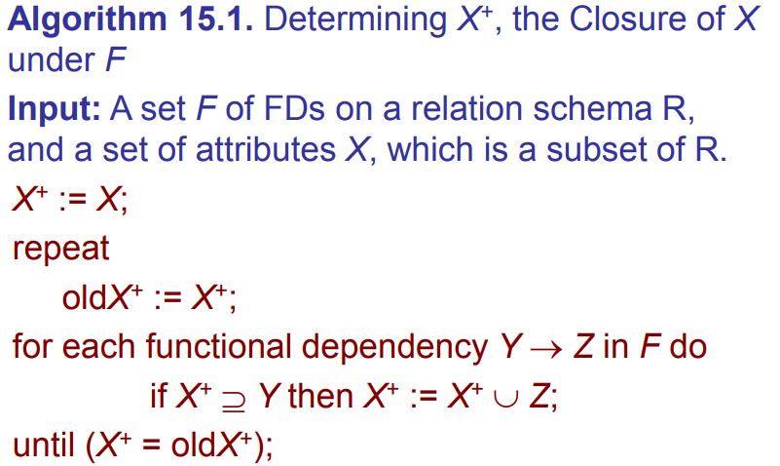
Algorithm to Calculate X⁺

Slide 51
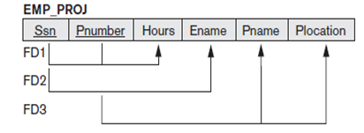
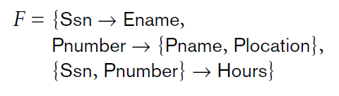

Example 1- Closure of Attributes
Consider the following relation
Closure sets with respect to F

Slide 52
Example 2- Closure of Attributes
Does F = {A ->B, B->C, CD -> E } imply A ->E?
  i.e, Is A -> E in the closure F⁺? Equivalently, is E in A⁺?
  Compute A⁺
    Initialize A⁺ to {A} : A⁺ = {A}
    From A -> B, we can add B to A⁺ : A⁺ = {A, B}
    From B -> C, we can add C to A⁺ : A⁺ = {A, B, C}
    We can not add any more attributes, and A⁺ does not contain E therefore A -> E does not hold

Slide 53

Example 3 -Closure of Attributes
For example, consider the following relation schema about classes held at a university in a given academic year
CLASS ( Classid, Course#, Instr_name, Credit_hrs, Text, Publisher,
Classroom, Capacity)
Let F, the set of functional dependencies for the above relation include the following f.ds:

Slide 54
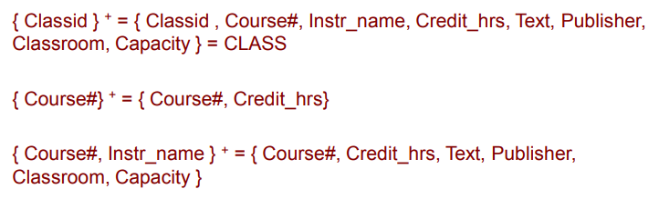
Example 3 -Closure of Attributes
The closures of attributes or sets of attributes for some example sets
Note that each closure above has an interpretation that is revealing about the attribute(s) on the left-hand-side.
The closure of { Classid }⁺ is the entire relation CLASS indicating that all attributes of the relation can be determined from Classid and hence it is a key

Slide 55
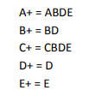
In-class Exercise
R = ABCDE, F = {A -> BE, C -> BE, B -> D}
Compute A⁺, B⁺, C⁺, D⁺, E⁺
Answer

Slide 56
Use of X⁺ 1: Checking if X→Y
Steps of checking if an FD X →Y is in the closure of a set of FDs F
  Compute X⁺ wrt F
  Check if Y is in X⁺
  Y∈X⁺ ⇔ X→Y is in F⁺
Does F = {A→B, B→C, CD→E } imply A→E?
  i.e, Is A → E in F⁺? Equivalently, is E in A⁺?
  A⁺ (w.r.t. F)={A,B,C}
  E is not in A⁺, thus, A→E is not in F⁺

Slide 57
In-Class Exercise
Let R(ABCDEFGH) satisfy the following functional dependencies F: {A->B, CH->A, B->E, BD->C, EG->H, DE->F}
Which of the following FD is also guaranteed to be satisfied by R?
  BFG ->AE
  ACG ->DH
  CEG-> AB
Hint: Compute the closure of the LHS of each FD that you get as a choice. If the RHS of the candidate FD is contained in the closure, then the candidate follows from the given FDs, otherwise not

Slide 58
In-Class Exercise
Solution
FDs: {A->B, CH->A, B->E, BD->C, EG->H, DE->F}
BFG ->AE ???
  Incorrect: BFG+ = BFGEH, which includes E, but not A
ACG ->DH ???
  Incorrect: ACG+ = ACGBE, which includes neither D nor H
CEG->AB ???
  Correct: CEG+ = CEGHAB, which contains AB

Slide 59
Use of X⁺ 2: Finding a key K
Let R be the set of attributes for a schema and F be its functional dependency set
Algorithm
    Set K:=R
    For each attribute A in K
      Compute (K-A)⁺ w.r.t. F
      If (K-A)⁺ contains all the attributes in R then set K:= K-A
This algorithm returns only one key out of the possible candidate keys for R
The key returned depends on the order in which attributes are removed from R

Slide 60
Use of X⁺ 2: Finding a key K
Which of the following could be a key for R(A,B,C,D,E,F,G) with functional dependencies {AB ->C, CD->E, EF->G, FG->E, DE->C, and BC ->A}?
  1. BDF
  2. ACDF
  3. ABDFG
  4. BDFG

Slide 61
Use of X⁺ 2: Finding a key K
Solution
  R(A,B,C,D,E,F,G)
  FDs : {AB->C, CD->E, EF->G, FG->E, DE->C, and BC->A}
  1. BDF ??? _x0001_
    No. BDF + = BDF
  2. ACDF ??? _x0001_
    No. ACDF + = ACDFEG (The closure does not include B)
  3. ABDFG ??? _x0001_
    No. This choice is a super key, but it has proper subsets that are also keys (e.g. BDFG + = BDFGECA)
  4. BDFG ???
    BDFG + = ABCDEFG
    Check if any subset of BDFG is a key:
      Since B, D, F never appear on the RHS of the FDs, they must form part of the key_x0001_
      BDF + = BDF Not key. So, BDFG is the minimal key, hence the candidate key

Slide 62
Finding Keys using FDs
Tricks for finding the key
  If an attribute never appears on the RHS of any FD, it must be part of the key
  If an attribute never appears on the LHS of any FD, but appears on the RHS of any FD, it of any FD, it must not be part of any key
  Example
    Consider R = {A, B, C, D, E, F, G, H} with a set of FDs
    F = {CD →A, EC →H, GHB →AB, C →D, EG →A, H →B, BE →CD,
    EC →B}
    Find all the candidate keys of R

Slide 63
Finding Keys using FDs
R = {A, B, C, D, E, F, G, H}
F = {CD →A, EC →H, GHB →AB, C →D, EG →A, H →B, BE →CD, EC →B}
Find all the candidate keys of R
Note
  EFG never appear on RHS of any FD. So, EFG must be part of ANY key of R _x0001_
  A never appears on LHS of any FD, but appears on RHS of some FD. So, A is not part of ANY key of R _x0001_
  We now see if EFG is itself a key… _x0001_
  EFG+ = EFGA ≠ R; So, EFG alone is not key

Slide 64
Finding Keys using FDs
R = {A, B, C, D, E, F, G, H}
F = {CD →A, EC →H, GHB →AB, C →D, EG →A, H →B, BE →CD, EC →B}
Checking by adding single attribute with EFG (except A):
BEFG+ = ABCDEFGH = R; it’s a key [BE →CD, EG →A, EC →H]
CEFG+ = ABCDEFGH = R; it’s a key [EG →A, EC →H, H →B, BE →CD] _x0001_
DEFG+ = ADEFG ≠ R; it’s not a key [EG ≠ R; it’s not a key [EG →A]
EFGH+ = ABCDEFGH = R; it’s a key [EG →A, H →B, BE →CD] _x0001_
If we add any further attribute(s), they will form the super key
Therefore, we can stop here searching for candidate key(s)
Therefore, candidate keys are: {BEFG, CEFG, EFGH}

Slide 65
In-Class Exercise
Consider R = {A, B, C, D, E, F, G} with a set of FDs
F = {ABC →DE, AB →D, DE →ABCF, E →C}
Find all the candidate keys of R
Note
  G never appears on RHS of any FD. So, G must be part of ANY key of R
  F never appears on LHS of any FD, but appears on RHS of some FD So, F is not part of ANY key of R _x0001_
  G⁺ = G ≠ R So, G alone is not a key!

Slide 66
In-Class Exercise - Solution
Try to find keys by adding more attributes (except F) to G
Add LHS of FDs that have only one attribute (E in E →C): _x0001_
GE⁺ = GEC ≠ R _x0001_
Add LHS of FDs that have two attributes (AB in AB →D and DE in DE →ABCF): _x0001_
GAB+ = GABD _x0001_
GDE+ = ABCDEFG = R; [DE = R; [DE →ABCF] It’s a key!
Add LHS of FDs that have three attributes (ABC in ABC →DE), but not taking super set of GDE: _x0001_
  GABC+ = ABCDEFG = R; [ABC →DE, DE →ABCF] It’s a key! _x0001_
  GABE+ = ABCDEFG = R; [AB →D, DE →ABCF] It’s a key! _x0001_
If we add any further attribute(s), they will form the superkey Therefore, we can stop here
The candidate key(s) are {GDE, GABC, GABE}

Slide 67
Use of X⁺ 3: Compute F⁺
Given a set of functional dependencies F, we define F⁺ to be the set of all functional dependencies that can be inferred from F
    F⁺ ={};
    For each attribute set A in R, computing A⁺
    For each X→Y implied by A⁺, add X→Y to F+

Slide 68


Equivalence of Sets of Functional Dependencies
Let E&F be two sets of functional dependencies
  F covers E if E F⁺
  E and F are equivalent if E⁺= F⁺
  E⁺= F⁺ iff E covers F and F covers E
Note: Equivalence means that every FD in E can be inferred from F, and every FD in F can be inferred from E
Determine whether F covers E
  For each FD X→Y in E, calculate X⁺ with respect to F, then check whether X⁺ Y

Slide 69
Equivalence of Sets of Functional Dependencies
Example : Check whether or not F is equivalent to G
  F={A→C, AC→D, E→AD,E→H}
  G={A→CD, E→AH}
Prove that F is covered by G
  {A}⁺= {A,C,D} (wrt to G). Since {C} A⁺, A→C can be inferred from G
  {AC}⁺= {A,C,D} (wrt to G). Since {D} {AC}⁺, AC→D is covered by G
  {E}⁺= {E,A,H,C,D} (wrt G), Since {AD} {E}⁺, E→AD is covered by G
  Since {H} {E}⁺, E→H is covered by G

Slide 70

Equivalence of Sets of Functional Dependencies
F={A→C, AC→D, E→AD,E→H}
G={A→CD, E→AH}
Prove that G is covered by F
  {A}⁺= {A,C,D} (wrt F), Since {CD} {A}⁺, A→CD is covered by F
  {E}⁺= {E,A,D,H,C} (with respect to F)
{A,H} {E}⁺, E→AH is covered by F
Since F covers G and G covers F, F and G are equivalent

Slide 71
Equivalence of Sets of Functional Dependencies – In-class Exercise
Example 2
  Let F1 = {A → C, AC → D, E → AD} and F2 = {A → CD, E → AH}. Are F1 and F2 are equivalent?
Check if F1 ⊆ F2⁺:
  A⁺ = ACD wrt F2
  AC⁺ = ACD wrt F2
  E⁺ = ACDEH (from E → AH, A → CD) wrt F2
    ie., if you know E then you know ACDEH according to the FDs of F2. Hence, the functional dependency E → AD of F1 is in F2
We are able to derive all the FDs of F1 from F2+ Hence, F1 ⊆ F2⁺ is TRUE

Slide 72
Equivalence of Sets of Functional Dependencies – In-class Exercise
Check if F2 ⊆ F1⁺
  A⁺= ACD wrt F1, So, A → CD of F2 is in F1
  E⁺ = ACDE, So, E → AH of F2 is not in F1
  Hence, F2 ⊆ F1⁺ is FALSE
  From the above, it is proved that F1 and F2 are not equivalent

Slide 73
Minimal Sets of Functional Dependencies
A set of functional dependencies F is minimal if it satisfies the following three conditions:
  1. Every FD in F has a single attribute for its right-hand side
  (This is a standard form, not a requirement)
  2. We cannot replace any dependency X→A in F with a dependency Y→A, where Y is a proper subset of X, and still have a set of dependencies that is equivalent to F
  3. We cannot remove any dependency from F and still have a set of dependencies that is equivalent to F
Note: There can be several minimal covers for a set of functional
dependencies
  We can think of a minimal set of dependencies as being a set of dependencies in a standard or canonical form and with no redundancies

Slide 74
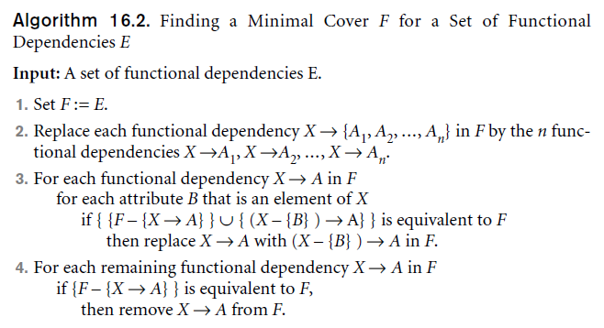
Minimal Sets of FDs
Definition
  A minimal cover of a set of functional dependencies E is a minimal set of dependencies (in the standard canonical form and without redundancy) that is equivalent to E. We can always find at least one minimal cover F for any set of dependencies E

Slide 75
Minimal Cover
Example 1
Find the minimal cover of the set of functional dependencies given below.
F= {A → C, AB → C, C → DI, CD → I, EC → AB, EI → C}
Steps of minimal cover
1. Right Hand Side (RHS) of all FDs should be single attribute - every dependency in a canonical form with a single attribute on the right-hand side
2. Remove extraneous attributes
3. Eliminate redundant functional dependencies
  Steps 2 and 3 ensure that there are no redundancies in the dependencies either by having redundant attributes on the left-hand side of a dependency (Step 2) or by having a dependency that can be inferred from the remaining FDs in F (Step 3).

Slide 76
Minimal Cover
F = {A → C, AB → C, C → DI, CD → I, EC → AB, EI → C}
Step 1:
  Right Hand Side (RHS) of all FDs should be single attribute. So we write F as F1, as follows:
  F1 = {A → C, AB → C, C → D, C → I, CD → I, EC → A, EC → B, EI → C}
Step 2 : Remove extraneous attributes
  Extraneous attribute is a redundant attribute on the LHS of the functional dependency
  In F1, the FDs, AB → C, CD → I, EC → A, EC → B, and EI → C have more than one attribute in the LHS. Hence, we check one of these LHS attributes are extraneous or not
  To check, we need to find the closure of each attribute on the LHS

Slide 77
Minimal Cover
  F1 = {A → C, AB → C, C → D, C → I, CD → I, EC → A, EC → B, EI → C}
  (i) A⁺ = ACDI
  (ii) B⁺ = B
  (iii) C⁺ = CDI
  (iv) D⁺ = D
  (v) E⁺ = E
  (vi) I⁺ = I
From (i), the closure of A included the attribute C. So, B is extraneous in AB → C, and B can be removed
From (iii), the closure of C included the attribute I. So, D is extraneous in CD → I, and D can be removed
No more extraneous attributes are found

Slide 78
Minimal Cover
we write F1 as F2 after removing extraneous attributes from F1
F2 = {A → C, C → D, C → I, EC → A, EC → B, EI → C}
Step 3: Eliminate redundant functional dependency
  None of the FDs in F2 is redundant. Hence, F2 is minimal cover

Slide 79
Minimal Cover
Example 2 : Find the minimal cover of the set of functional dependencies given; {A → BC, B → C, AB → D}
Step 1. Right Hand Side (RHS) of all FDs should have single attribute. So we write F as F1, as follows;
  F1 = {A → B, A → C, B → C, AB → D}
Step 2: Remove extraneous attributes
  B⁺ = BC
  A⁺ = ABCD
so B is extraneous, ie., we can identify D without B on the LHS. Now, we can write the new set of FDs, F2 as follows;
F2 = {A → B, A → C, B → C, A → D}
Step 3: Eliminate redundant functional dependency
  If A → B, and B → C, then A → C is true (according to transitive rule). Hence, the FD A → C is redundant. We can eliminate this and we get final set of FDs F3 as follows:
F3 = {A → B, B → C, A → D} - minimal cover of F

Slide 80
Minimal Cover – In-Class Exercise
F= {A → BC, B → C, A → B, AB → C}
Step1 : Put FDs in standard form
  M = {A → B, A → C, B → C, AB → C}
Step 2: Minimize left side of each FD
  M = {A → B, A → C, B → C, AB → C}
  M = {A → B, A → C, B → C}
Step 3: Delete redundant FDs
  M= {A → B, A → C, B → C}
  M= {A → B, B → C} – Minimal Cover of F
  Note : Closure of M = Closure of F

